Slide 1


Reference Sets in Viral Genomics: Robert J. Gifford
Photo by Stefan Els

Slide 2
What is a Reference Set?
A curated collection of sequences chosen to anchor analysis.
Provides context for:
Alignments
Phylogenetic trees
Genotyping and annotation
Acts as a baseline against which new or unknown sequences are compared.
🧬
Notes:
Reference sets aren’t just “any collection of sequences.” They’re carefully chosen to represent known diversity.
They ensure we compare new data in a meaningful way — for example, genotyping or tracking evolution.
Think of them as the scaffold that everything else hangs on: alignment, trees, even metadata interpretation.

Slide 3
What is a Reference Set?
“Raw sequences” + “Reference set” → “Alignment” → “Tree”
Notes:
Reference sets aren’t just “any collection of sequences.” They’re carefully chosen to represent known diversity.
They ensure we compare new data in a meaningful way — for example, genotyping or tracking evolution.
Think of them as the scaffold that everything else hangs on: alignment, trees, even metadata interpretation.

Slide 4
Why Do Reference Sets Matter?
Shape the accuracy of alignments
bad references → misaligned regions.
Influence phylogenetic trees
different reference sets can shift topology.
Reduce bias by balancing representation.
Provide interpretability
results only make sense relative to good context.
Notes:
If you choose a poor reference set (e.g. only recent outbreak isolates, or biased to one host region), your analysis will skew.
Alignments may look broken if critical diversity is missing.
Phylogenies can cluster strangely because the “scaffold” is distorted.
A well-designed reference set provides a stable baseline that makes downstream results interpretable.

Slide 5

Sources of Reference Sequences
GenBank
Strengths:
Largest open-access virus database.
Long-term archive with >1M IAV sequences, >500k IBV.
Challenges:
Genome segments stored separately → harder to reconstruct full genomes.
Inconsistent isolate metadata (host, location, date, clinical info).
Variable accuracy/annotation quality.
Limited taxonomy (often only subtype level, lineage rarely consistent).
Very large datasets → difficult to manage at scale.
Notes:
GenBank is indispensable, but not “curated for flu.”
Segment-based storage is a headache: each of the 8 influenza segments is a separate record.
Metadata is inconsistent — sometimes host or location is missing, sometimes it’s embedded in the strain name.
Taxonomy is shallow: “H1N1” may be as far as it goes.
Volume is a double-edged sword: lots of data, but you need tools to filter and structure it.

Slide 6

Sources of Reference Sequences
GISAID
Strengths:
Rich, curated metadata (host, date, location standardized).
Near-real-time coverage of influenza & SARS-CoV-2.
Lineage/phylogeny assignments often included.
Collaborative ethos → credit to data generators.
Challenges:
Controlled access → must register, agree to terms.
Restricted redistribution of sequences.
Coverage focused on major pathogens (influenza, SARS-CoV-2) — not comprehensive.
Metadata occasionally inconsistent across submitters.

Slide 7
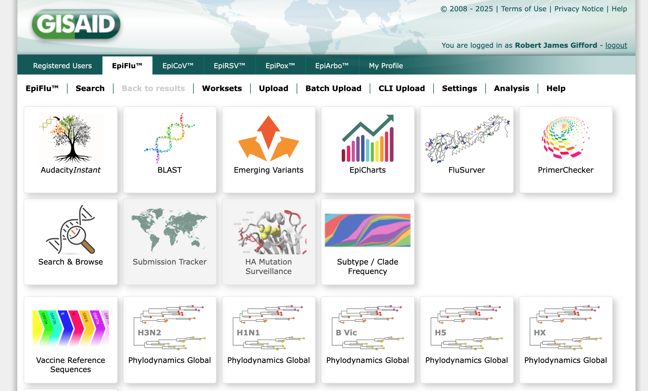
Sources of Reference Sequences

Slide 8
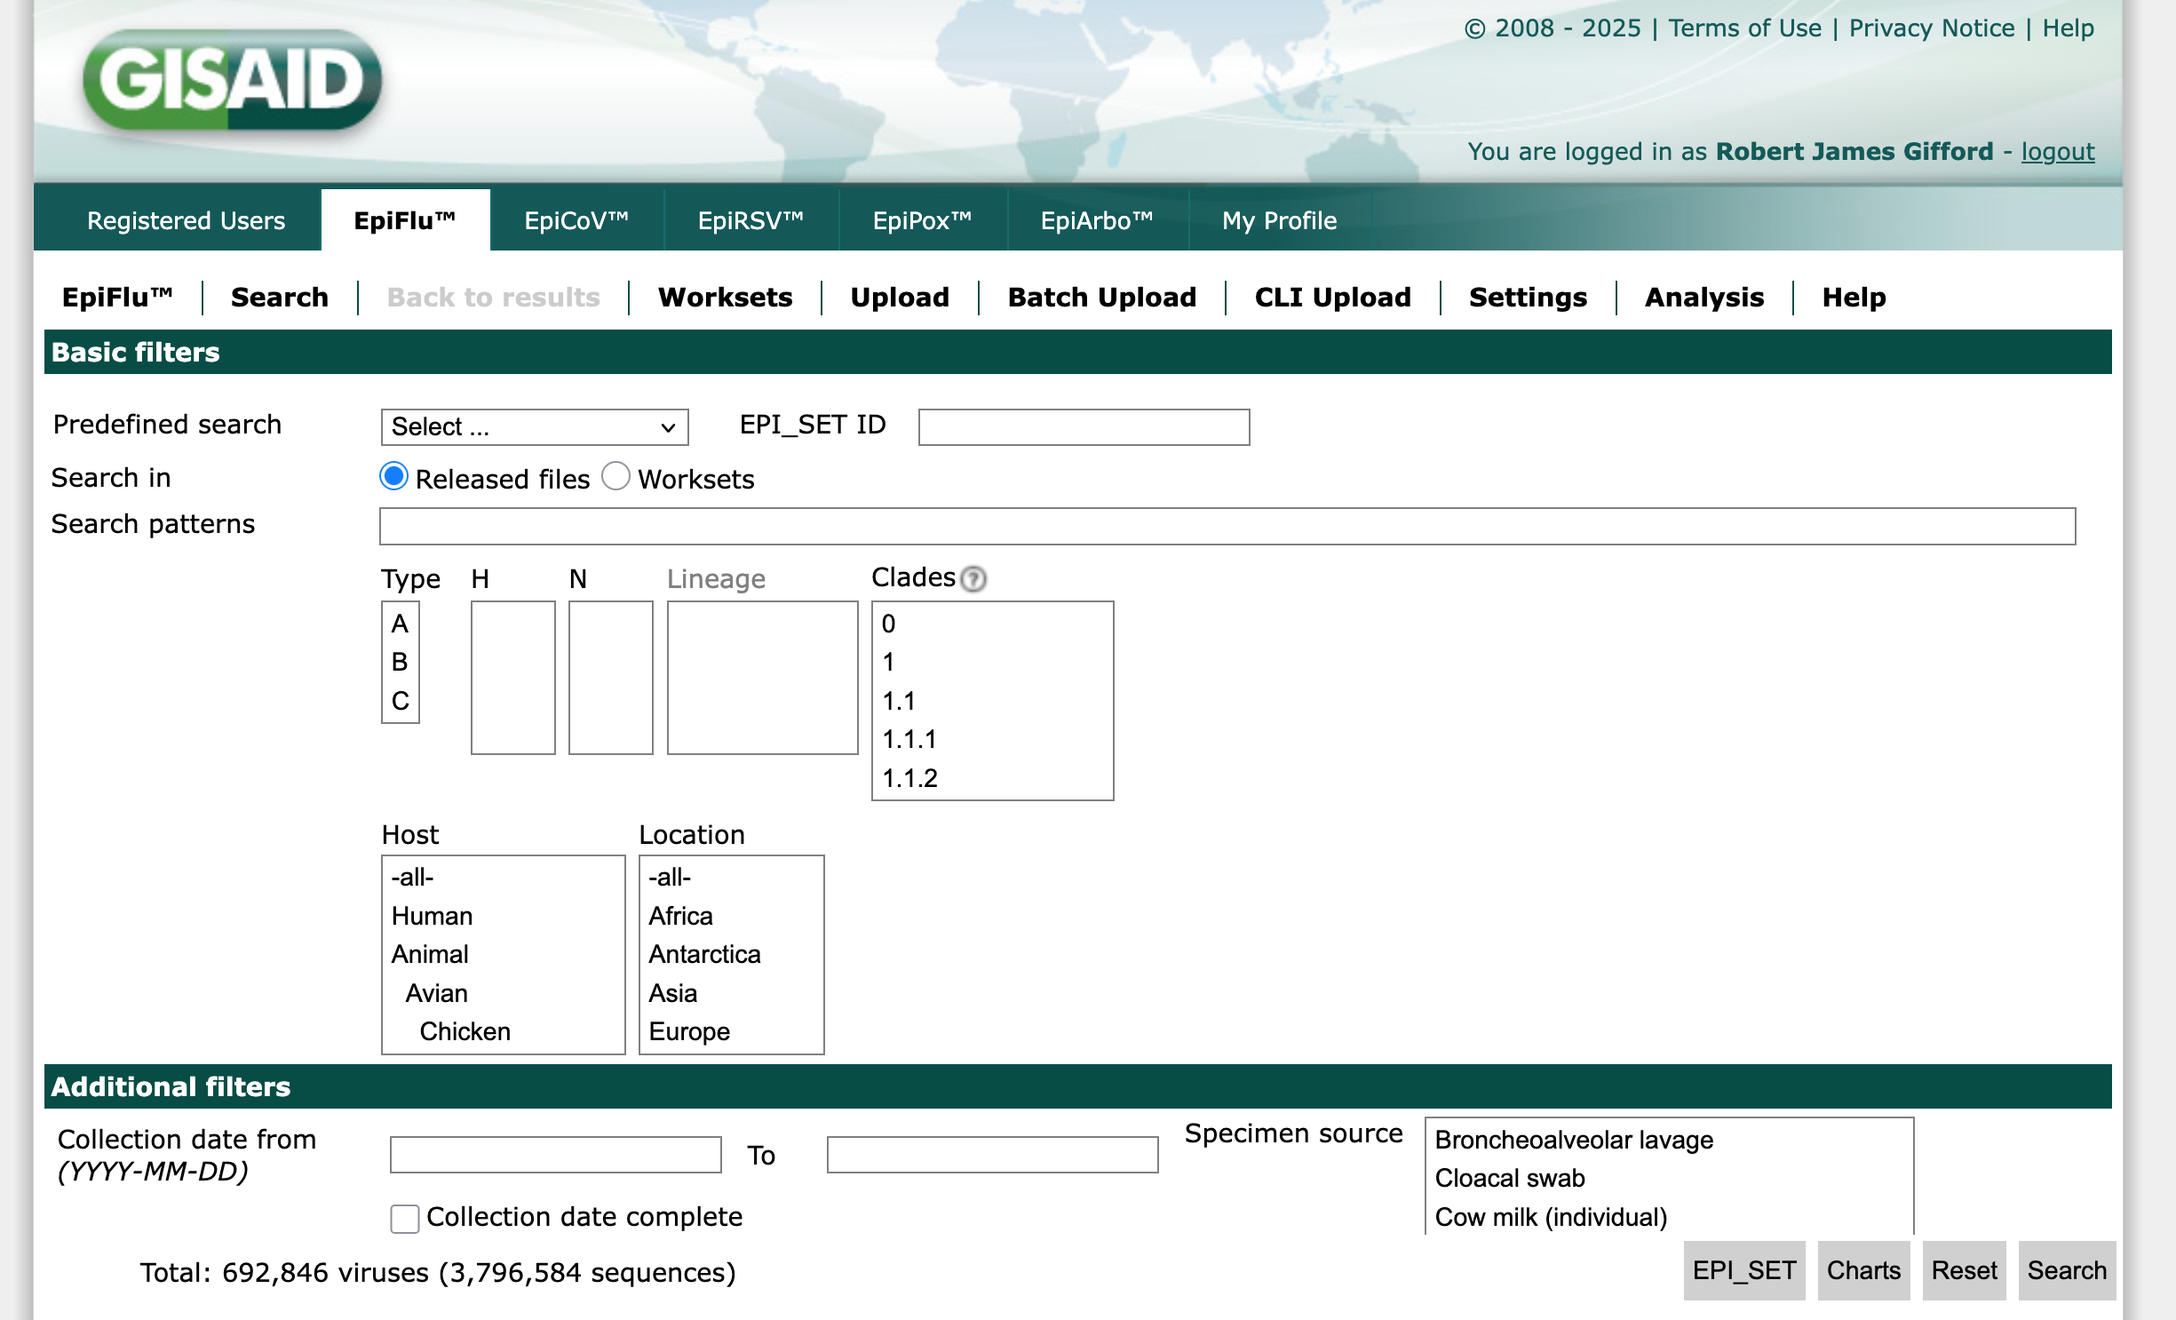
Sources of Reference Sequences

Slide 9

Sources of Reference Sequences
NextStrain
Strengths
Provides curated reference datasets for specific pathogens.
Challenges
Reference sets tailored to specific builds → not comprehensive.
Coverage focused on major pathogens (e.g. Flu, SARS-CoV-2, Ebola).
Less suited for deep historical or lineage-wide reference curation.
Not a general-purpose sequence archive.

Slide 10

Sources of Reference Sequences
PathoPlexus
Strengths
Open-source, non-profit platform for all human viral pathogens.
Integrates with Nexstrain, INSDC (NCBI/ENA/DDBJ).
Community-driven governance, transparent policies.
Offers SeqSets and APIs for filtering/search.
Flexible data-sharing: immediate open or embargoed.
Challenges
Still emerging → limited pathogen coverage so far.
Focused on human pathogens, not broader host range.
Curation depth varies by virus.
Dependent on community participation for sustainability.

Slide 11
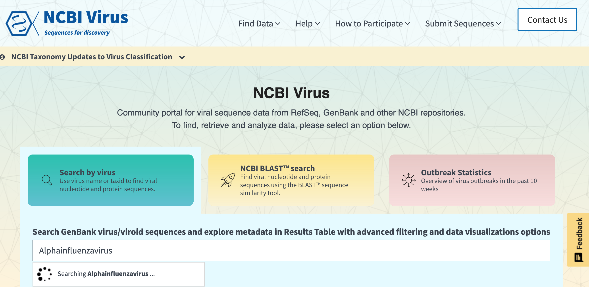
Virus Reference Sequences
Notes:
Looking up individual reference sequences for virus species/strains
Sometimes the research community will agree on a defined set of reference sequences for a virus
NCBI also collates virus reference sequences
Where the reference sequence is used to define the coordinate space it will impact how mutations are named

Slide 12
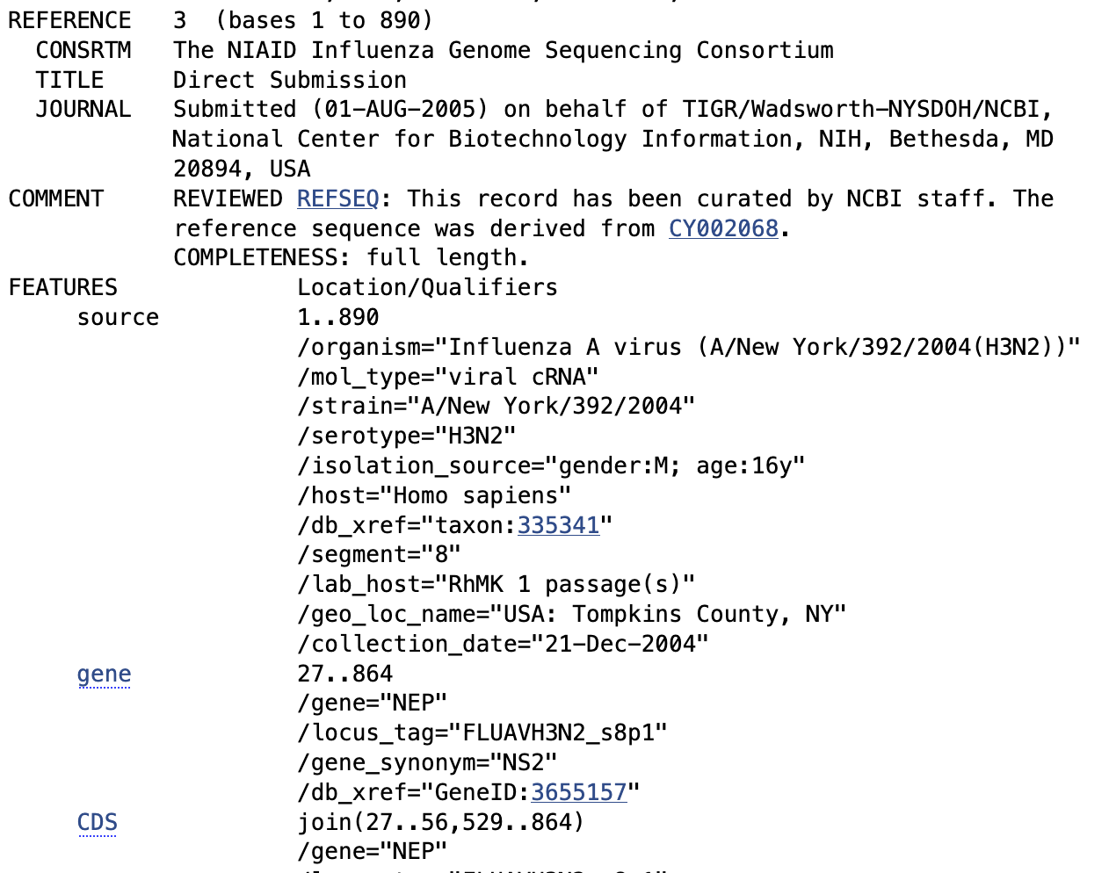
GenBank Influenza Virus Entry
Notes:
Walk through a single GenBank flu entry live (or with screenshot).
Point out where the segment is noted (or not noted!).
Highlight strain name: often contains a lot of metadata, but not in a machine-friendly way.
Show the structured fields (host, country, collection date). Sometimes present, sometimes absent.
Emphasise: influenza is relatively well-curated compared to, say, other RNA viruses — but still imperfect.

Slide 13
GenBank Influenza Virus Entry
Each genome segment = separate record.
Isolate details partly in strain name, partly in extra fields.
Metadata (host, location, date) often inconsistent or missing.
For influenza, formatting is more standardised than for many viruses — but still patchy.
Notes:
Walk through a single GenBank flu entry live (or with screenshot).
Point out where the segment is noted (or not noted!).
Highlight strain name: often contains a lot of metadata, but not in a machine-friendly way.
Show the structured fields (host, country, collection date). Sometimes present, sometimes absent.
Emphasise: influenza is relatively well-curated compared to, say, other RNA viruses — but still imperfect.

Slide 14
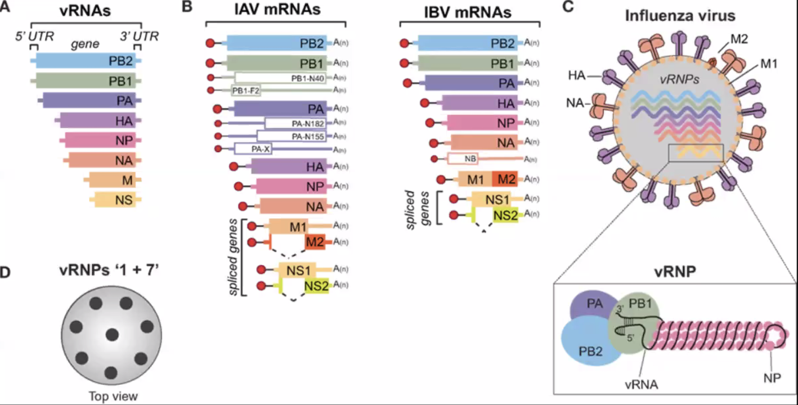
Influenzavirus Genomes
Notes:
The segmented nature of influenzavirus genome is an important consideration for how the sequence data are organised in databases. IAV and IBV have eight segments.

Slide 15
Selecting Reference Sets (Web)
GenBank:
Searchable, but limited filters.
Hard to select by segment or isolate fields.
GISAID:
Advanced filters (host, date, clade, geography).
Better for curated sets — but export restrictions.
Nextstrain:
Provides curated, ready-to-use reference sets.
Useful as examples/templates, not always comprehensive.
Notes:
Web portals are easy entry points, but not ideal for systematic selection.
In GenBank, you can’t reliably filter by segment, though you can filter by gene (e.g. HA only).
GISAID provides a lot more power: you can filter by metadata fields and clade/lineage, which is great — but you can’t freely redistribute what you download.
Nextstrain’s reference sets are a huge convenience — but they’re designed for specific builds, not as general-purpose repositories.
Key takeaway: web tools are great for exploration, but limited for reproducible workflows.

Slide 16
Selecting Reference Sets (CLI)
Entrez Tools (NCBI):
esearch + efetch → programmatic access.
Reproducible queries (e.g. by host, segment, date).
Nextstrain Augur:
Higher-level filtering & downsampling.
Integrates metadata + sequence selection.
Notes:
The command line gives you control and reproducibility.
With Entrez, you can precisely specify which sequences you want (e.g. “H3N2, HA, human, 2015–2020”).
Nextstrain augur adds extra logic — you can group, filter, downsample — things the web portals can’t do.
Docker removes the “it works on my machine” problem: everyone runs the same software environment.
This is the workflow we’ll use in the tutorial.

Slide 17

Why Use Docker?
Consistency: same environment across all computers.
Portability: runs on Linux, Mac, Windows.
Reproducibility: ensures identical results for everyone.
Convenience: no dependency hell (prepackaged software).
Notes:
One of the biggest barriers in bioinformatics is “it works on my machine but not yours.”
Docker solves this by packaging the software and its dependencies into a container.
You can pull the same container and know you’re running exactly what I’m running.
For this tutorial, Docker is what makes it possible to run Nextstrain tools smoothly, without everyone needing to install things differently.

Slide 18

Quality Control of Reference Sets
Remove low-quality or incomplete sequences.
Check for frame shifts, stop codons, sequencing errors.
Confirm correct genotyping (e.g. HA subtype for influenza).
Tools: Nextclade (genotyping + QC in one step).
Notes:
Once you’ve assembled candidate reference sequences, you need to clean them up.
Problems include sequencing errors, partial sequences, or mislabeled isolates.
Nextclade is especially useful for flu: it assigns genotypes, checks sequence quality, and highlights issues.
A good reference set = high-quality AND representative. Without QC, your downstream alignment and phylogeny will be unreliable.

Slide 19
Alignment & Tree Building
Multiple Sequence Alignment (MSA):
Align sequences against reference set.
Anchors homologous sites across genomes.
Tree Building:
Infer evolutionary relationships from aligned data.
Reference set provides stable “scaffold” for new sequences.
Tools (Nextstrain, Docker):
Alignment → augur align
Phylogeny → augur tree + augur refine
Notes:
Alignment is where reference sets really show their importance — they determine how well sequences are lined up and which regions are comparable.
The phylogeny (tree) is then built from this alignment, showing relationships between isolates.
Nextstrain’s augur pipeline wraps alignment and tree building into a reproducible workflow.
Docker ensures that participants get the same results on any system.
The reference set functions like a “backbone” → you add new sequences onto it, keeping the tree stable and interpretable.

Slide 20
Key Points
Reference sets = foundation of viral sequence analysis.
Good sets are: representative, high-quality, balanced, fit-for-purpose.
Sources differ:
GenBank = comprehensive but messy.
GISAID = curated but controlled.
Pathoplexus/NextStrain = pre-curated.
Web portals = exploration.
Command line + Docker = reproducibility.
QC, alignment, and tree building depend on having a robust reference set.
Notes:
Everything we do downstream depends on having the right reference set.
Different sources and tools give different trade-offs.
The point is not just to grab sequences, but to think carefully about context, quality, and reproducibility.

Slide 21
Now It’s Your Turn
We’ll walk through:
Downloading sequences (GenBank web & CLI).
Running QC with Nextclade.
Filtering with Augur.
Building a tree with Nextstrain.
Notes:
Now we’re going to make this real.
You’ll get hands-on experience: from raw sequence retrieval, through QC and filtering, to building a tree.
This will let you see how the lecture concepts play out in practice.

Slide 22


OVER TO YOU!!
Photo by Stefan Els
Notes:
Cover/End Slide Layout
The maroon rectangle and ghost text placeholder is fully scalable and movable, as is the SU logo.
To change the image:
Select it, then click on the Picture Format tab.
Click on the Change Picture icon and choose the From a File option .
Browse and select a picture and click on the Insert button.
Use the Crop command to adjust the image.
Click on the Crop command again to apply the changes.
Remember to add image attributions to photographs or artworks.

